Slide 1
Webinar:
OGC API – EDR Sprint 2 |
Gobe Hobona, Chris Little
November 4th, 2020
#OGCAPI

Slide 2
Webinar Agenda
Welcome (5 minutes)
Overview of the OGC API - Environmental Data Retrieval candidate standard (20 minutes)
API definition and examples (10 minutes)
Questions & Answers (25 minutes)

Slide 5
Invitation to the Code Sprint
OGC invites you to the OGC API – EDR Sprint 2 virtual event, to be held virtually on:
Day 1: Monday 9 November from 09:00am to 05:30pm EST.
Day 2: Tuesday 10 November from 09:00am to 05:30pm EST.
What is an OGC Code Sprint?
A collaborative and inclusive event driven by innovative and rapid programming with minimal process and organization constraints to support the development of new applications and open standards.

Slide 6
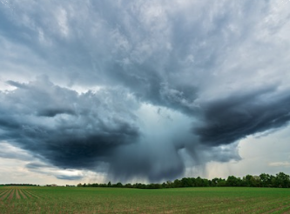

Motivation
Data sharing is a key aspect of environmental management and protection
APIs are an effective and increasingly popular method for rapid software development
There is a growing need for interoperability between Web APIs
Photo above by NOAA on Unsplash
Photo above by John O'Nolan on Unsplash
Notes:
Photo by John O'Nolan on Unsplash
Photo by NOAA on Unsplash

Slide 7
Overview of the draft specification
OGC API – Environmental Data Retrieval

Slide 8
Examples
API Definition and Examples

Slide 9
Sprint Description
A major objective of this Code Sprint is to enable full interoperability of all existing, and new, client and server implementations that support the OGC API – EDR candidate standard.
All participation will be remote, through web-conferencing services provided by OGC.
Participants are welcome to bring partial or complete implementations of servers or clients to support the sprint.
Participants will have the opportunity to experiment with parts of the specification and to develop working services.

Slide 10
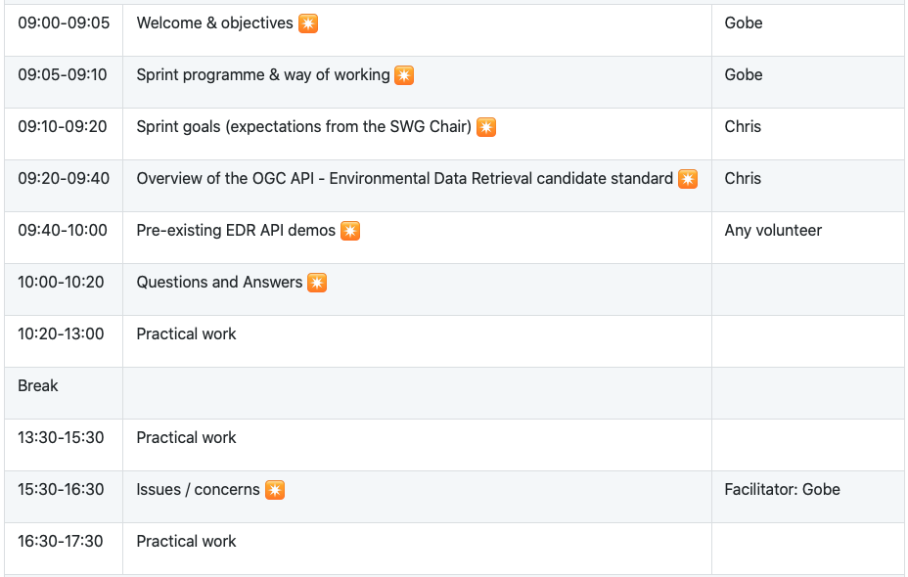
Sprint Schedule: November 9th, 2020

Slide 11
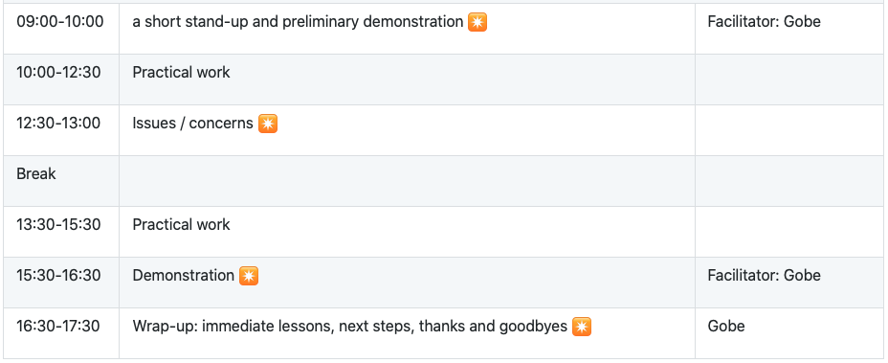
Sprint Schedule: November 10th, 2020

Slide 12
Logistics
Gotomeeting
Link to be provided to registered participants only.
Gitter
https://gitter.im/opengeospatial/OGCAPI-EDR-Sprint2
GitHub
Sprint repo https://github.com/opengeospatial/OGCAPI-EDR-Sprint2

Slide 13
Community
500+ International Members
110+ Member Meetings
60+ Alliance and Liaison partners
50+ Standards Working Groups
45+ Domain Working Groups
25+ Years of Not for Profit Work 10+ Regional and Country Forums
Innovation
120+ Innovation Initiatives
380+ Technical reports
Quarterly Tech Trends monitoring
Standards
65+ Adopted Standards
300+ products with 1000+ certified implementations
1,700,000+ Operational Data Sets Using OGC Standards
Contact info@ogc.org to schedule a meeting for an in-depth discussion with OGC staff and join our community today!
Notes:
If you have any questions, do not hesitate to reach out to OGC or schedule a follow-up. We’re working constantly to change the landscape of location information and want to help your organization get where it needs to go.

